Slide 1
FREIA Laboratory for Accelerator and Instrumentation Development
Introduction to the visit of the Management of the
Swedish Research Council (VR)
to FREIA
2017-09-15

Slide 2
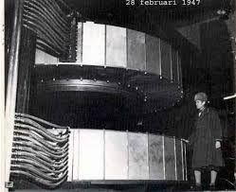
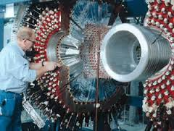
Uppsala university has been maing accelerator
development since the 1950
In the 1950s: Construction in Uppsala of the first synchrocylclotron (SC) as the then highest energy accelerator i Europe with its energy 185 MeV, followed 2 years later by Uppsala provding essential contributions to the build-up of CERNs first accelerator, the 600 MeV synchrocylclotron.
In the 1970s and 1980s design the conversion of the Uppsala SC to a sector focussing cyclotron followed by the design and build-up of 1.5 GeV proton storage ring CELCIUS and the WASA detector which were operated during the 1990s. Considerable VR support.

Slide 3
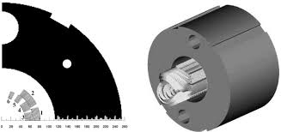
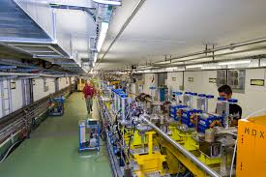
In 1994-1996 participation at CERN in the design, fabrication and test of the first 1 m prototype MFISC of the 1300 superconducting dipoles for LHC. VR-support ca 2 Mkr.
Since 1995 till now participation in the CLIC prototype tests at CERN, in the 1990’s with design and test of Beam Position Monitors in the CLIC Test Facility 2 and from 2005 till 2016 with design, build-up and tests of the Two-Beam Test-Stand in the CLIC Test Facility 3 CTF3, now continued with DC spark vacuum break-down studies at CERN and in FREIA. VR support ca 12 Mkr.

Slide 4
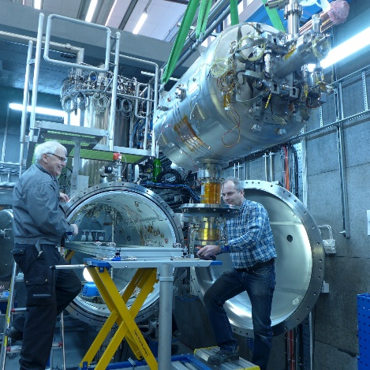
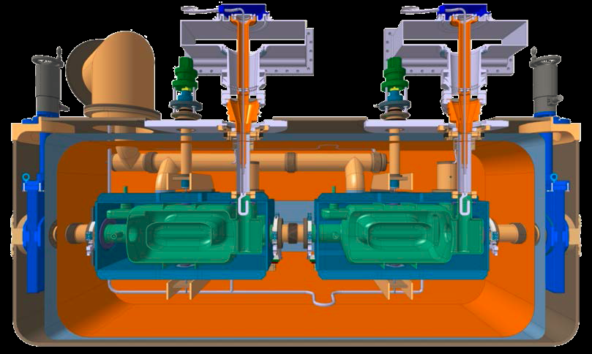
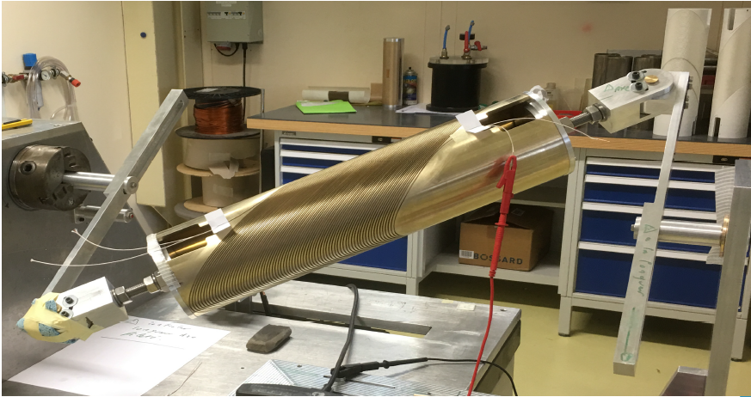
In 2009-2015 build-up of the FREIA Laboratory for a program of developments and tests of ESS accelerator superconducting accelerating cavities, first tests of the spoke cavity prototype at full power in 2016-2017 to be followed of spoke-cavity series-production acceptance tests and now elliptical cavity prtottype full power tests taken over from CEA Saclay. Support from the Government, KAW, ESS and UU
In 2018-2020 tests for the CERN LHC HighLumi upgrade of superconducting crab cavities and superconducting orbit-corrector dipoles under the first Swedish so-called K-contract with CERN. Support from CERN and UU.
Currently in discussion of two more LHC High-Lumi related K-contacts with CERN: one involving Scanditronix Magnets AB and APR Technologies AB for first production in Sweden of superconducting magnets and the other involving RFR Solutions AB for production of superconducting connection boxes. Support from ???

Slide 5
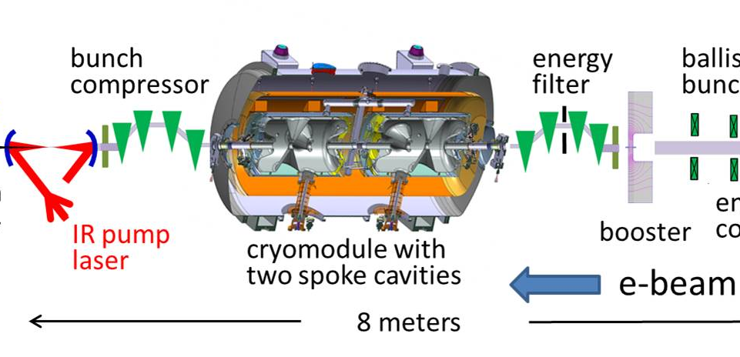
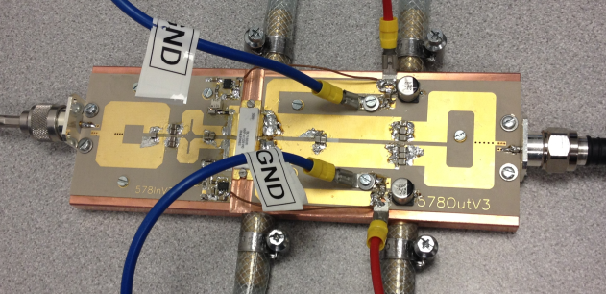
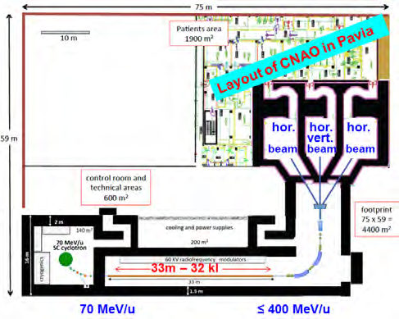
Other ongoing or planned FREIA projects
Doubling of the linac power
and compression of the proton
pulse for the ESS Neutrino
Super-Beam (ESSnuSB) project
Financing: COST 5 Mkr + H2020
30 Mkr
Commission the Laser Heater for X-FEL. VR ca 10 Mkr
Enabling technology
of generation of
single-cycle light-beams
High-power transistors for radio-frequency power generation for scientific and industrial accelerators
Superconducting Radioisotope
Producing Cyclotrons and Light
IonHadron Therapy Cyclinac
Development of
Control system for
ESS modulators

Slide 6
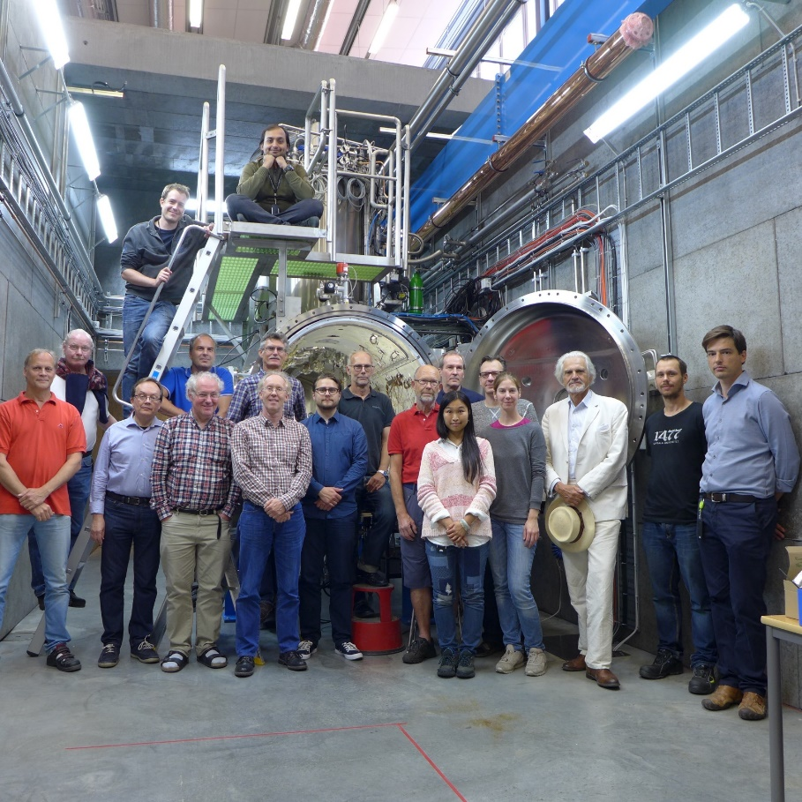
Personnel
8 senior staff have been recruited from the former National Uppsala Accelerator Laboratory TSL.
New recruitments of mostly younger members of the personnel have been made through wide international announcements.
Two out of the currently three recruitments made from outside Sweden (from China, Spain and Ukraine) are women.

Slide 7


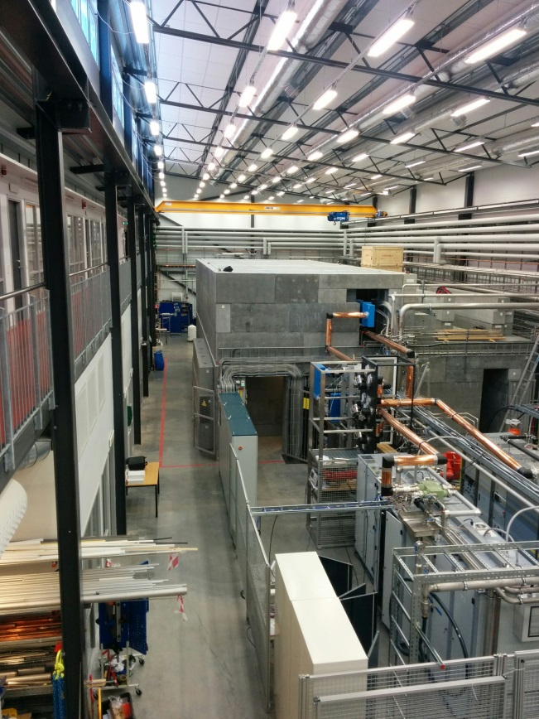
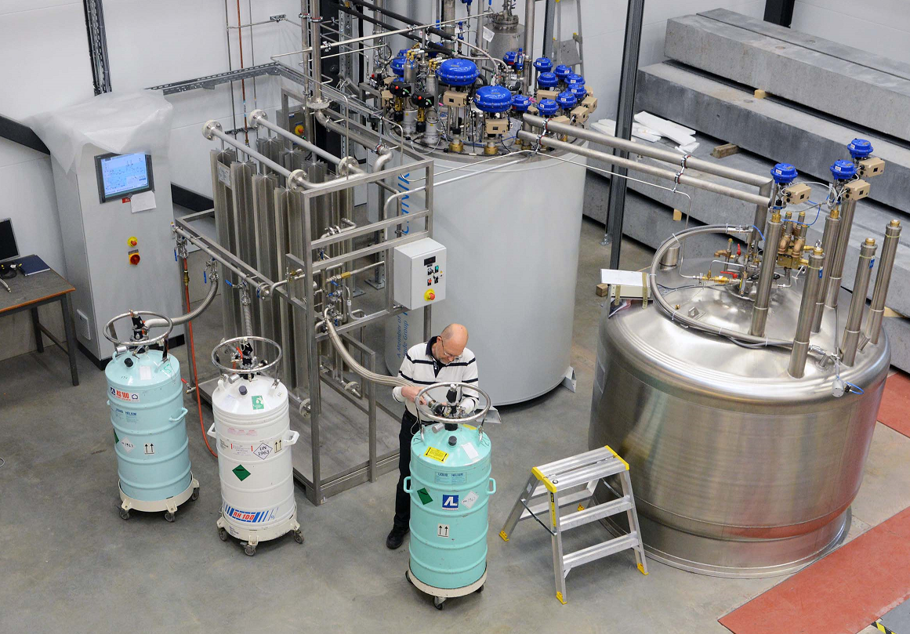
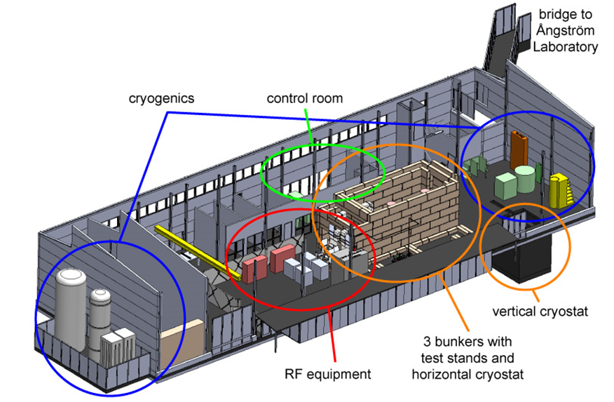
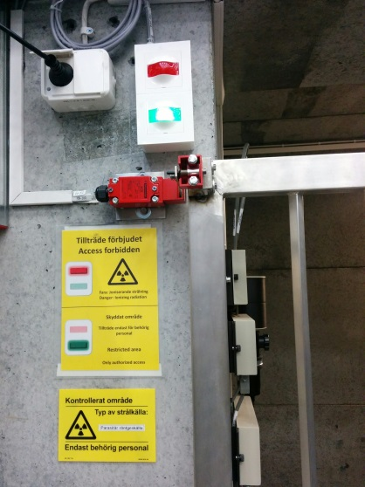
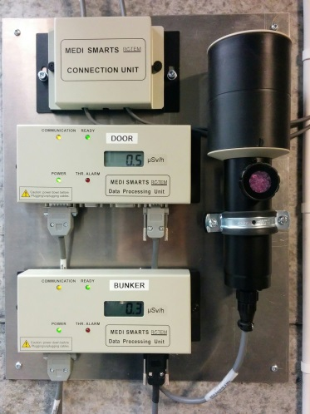
Infrastructure
Major high-tech infrastructure for accelerator and instrumentation development and tests.
The nearby Ångström Mechnical Workshop with its highly qualified workshop personnel and large set-up of modern numerical workshop machines is a significant asset for FREIA.
The FREIA laboratory will have to continuously develop and complement its infrastructure when collaborations on new projects will be added to the current activities.
Funding will be needed in future not only to cover the operational costs but also for investments in new infrastructure.
FREIA stands for "Facility for Research Instrumentation and Accelerator Development". The FREIA Laboratory was established in 2011 within the department of Physics and Astronomy at Uppsala University, to develop and test new particle accelerator and detector instrumentation. Freia is located at the Ångström Laboratory campus and was inaugurated in 2013.
Cryo Plant
The Hall
1000 m² large, 10 m high. Has a 6.3-ton movable crane and other mechanical equipment, office space for ~15 people, small workshops for mechanics and electronics and 50 m² control room.
Cryogen Distribution
The cryogenic facility produces and distributes liquid helium and provides liquid nitrogen to the test cryostats in the FREIA Laboratory
In addition it provides these cryogens to all other research departments at the University.
Bunkers
Three concrete bunkers for equipment producing ionizing radiation.
1 bunker, 10.4 m x 4.0 m x 4.8 m high, with cryostat
2 bunkers, dimension 4.0 m x 2.8 m x 2.4 m high
Monitoring systems for ionizing radiation and oxygen deficiency
Helium Liquefier
Helium liquefier 140 l/h at 1.15 bar.
Liquid helium storage dewar 2’000 l.
Liquid nitrogen storage dewar 20’000 l at 3 bar.
High pressure helium gas storage, 11 m³ at 200 bar.
High pressure helium gas recovery compressor station, 75 m³/h at 200 bar.
Impure helium recovery gas storage balloon 100 m³.
Helium gas sub-atmospheric pumping system, 3 g/s at 10 mbar
Radiation Safety
Interlock system prevents entry into the experimental bunker
Area monitoring detectors outside and inside the bunker
FREIA stands for "Facility for Research Instrumentation and Accelerator Development". The FREIA Laboratory was established in 2011 within the department of Physics and Astronomy at Uppsala University, to develop and test new particle accelerator and detector instrumentation. Freia is located at the Ångström Laboratory campus and was inaugurated in 2013.
Cryo Plant
The Hall
1000 m² large, 10 m high. Has a 6.3-ton movable crane and other mechanical equipment, office space for ~15 people, small workshops for mechanics and electronics and 50 m² control room.
Cryogen Distribution
The cryogenic facility produces and distributes liquid helium and provides liquid nitrogen to the test cryostats in the FREIA Laboratory
In addition it provides these cryogens to all other research departments at the University.
Bunkers
Three concrete bunkers for equipment producing ionizing radiation.
1 bunker, 10.4 m x 4.0 m x 4.8 m high, with cryostat
2 bunkers, dimension 4.0 m x 2.8 m x 2.4 m high
Monitoring systems for ionizing radiation and oxygen deficiency
Helium Liquefier
Helium liquefier 140 l/h at 1.15 bar.
Liquid helium storage dewar 2’000 l.
Liquid nitrogen storage dewar 20’000 l at 3 bar.
High pressure helium gas storage, 11 m³ at 200 bar.
High pressure helium gas recovery compressor station, 75 m³/h at 200 bar.
Impure helium recovery gas storage balloon 100 m³.
Helium gas sub-atmospheric pumping system, 3 g/s at 10 mbar
Radiation Safety
Interlock system prevents entry into the experimental bunker
Area monitoring detectors outside and inside the bunker

Slide 8
Academic culture
The FREIA research and development results are presented by FREIA scientists at seminars and international conferences and published in refereed journals, conference proceedings and internal reports.
FREIA staff are contributing to the teaching to a variety of undergraduate and graduate courses at the University
FREIA is inviting external scientists to give seminars at the Department of Physics and Astronomy (Carlo Rubbia of CERN, Ken Long of Imperial College and John Womersley of ESS are examples of renowned scientists recently invited to give FREIA seminars).
The FREIA activities regularly reviewed at the weekly meetings of the FREIA Division.

Slide 9
Finances
EU-projects in which FREIA is a partner – EU contributions:
ARIES 337 kEURO
EuroNuNet 16 kEURO
AMICI 100 kEURO
ESSnuSB 485 kEURO
CompactLight 130 kEURO
---------------------------------
SUM 1.068 MEUO
The regular operations budget from the Faculty to FREIA is 0.1 MEUR/year.

Slide 10
Finances
The currently acquired financing will cover the FREIA operational costs up till spring 2020.
During the time till then more collaborative contracts with scientific partners need to be signed and a source providing a regular operations budget covering about half of the operational costs, i.e. 1.2 MEURO/year, needs be found.
As the activity of FREIA may be seen as a national resource, in particular when it comes to stimulating and procuring high-technology orders to Swedish industry from the large international research infrastructures like ESS, LHC, CLIC, X-FEL and in future FAIR, ITER, MYRRHA, ILC, FCC and others, we argue that the activity should be supported from national, not only local, funds.

Slide 11
Teaching
8 FREIA lecturers
giving
lecture hours
and
158 laboratory instruction
hours

Slide 12
Leadership
The FREIA Division Head (Tord Ekelöf) is planning and negotiating the commitment of the FREIA laboratory to new collaborative projects. Major projects committing the whole FREIA Laboratory are led and coordinated by the Project Manager (Roger Ruber). The daily work in the laboratory is led by the Laboratory Manager (Lars Hermansson).
All decisions are discussed, before they are taken, by the Division management with the whole personnel during the weekly meetings held every Monday from 2 to 4 pm.
There are also smaller projects which are led by individual Division members.
An acute problem is the absence of a regular FREIA operations budget preventing the planning of a longer term future research program and for matching contributions from the FREIA side when negotiating new collaborative projects. The resources are also needed to enable the recruitment of a professor in accelerator and instrumentation physics to lead the laboratories scientific program in future. The currently accumulated project financing will allow the activity in the Laboratory to continue only up to 2020.

Slide 13
Link/communication with department, faculty, university, other universities and industry
The Head of FREIA Division participates in the weekly meetings of the Division Heads and in the Preparatory Meetings for the Department Board.
The leadership and support from the managements on the Physics and Astronomy Department, the Faculty and the University management levels has been of decisive importance for the creation and further development of the FREIA Laboratory.
The absence of a formal Faculty Program in Accelerator and instrumentation physics prevents the recruitments of tenure positions (lecturerships and professorships) in the Divison.
In order to motivate and obtain external operational support it will be important to establish FREIA as a national facility.
Since, in the end, almost all of the series production of new components for basic research infrastructures has to be made in industry, the involvement of industry already in the development phase is a absolutely necessary condition for the advancement of basic research.

Slide 14
“The Valley of Death”
The lack of financial support in Sweden for development of the new accelerator and instrumentation technology is due to an outstanding void - sometimes called “The Valley of Death” - between the support for basics science provided by the Swedish Research Council VR and the support for technological development provided by the Swedish Innovation Authority Vinnova.
The link and mutual cooperation between VR and Vinnova needs to be strengthened.
There has till now been a nearly total absence of high-tech orders from European Accelerator Laboratories to Swedish industry which is largely due to this absence of cooperation between VR and Vinnova and to the concomitant lack of financial support for a Swedish Technological Platform of the kind FREIA represents.
Even so, the Valley of Death problem exists, be it on a more reduced level, also in other European countries. FREIA is a member of an EU-supported network AMICI (Accelerator and Magnet Infrastructure for Cooperation and Innovation) of European so called Technological Platforms. AMICI is studying the problem of the sustainability of these European Platforms and thereby also the future possibility to build-up new large Research Infrastructures in Europe.

Slide 15
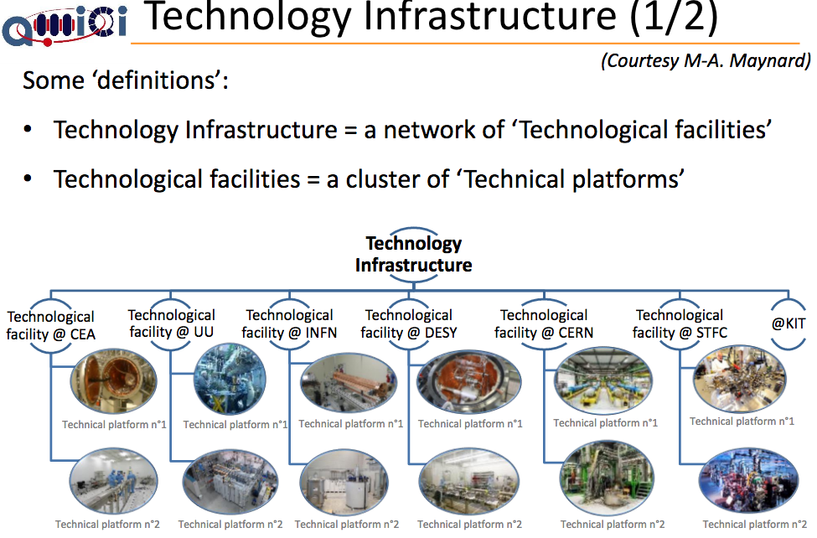
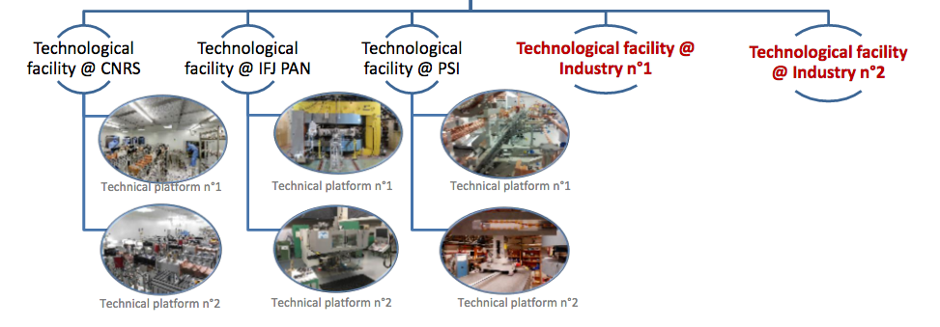
AMICI
Accelerator and Magnet Infrastructure for
Cooperation and Innovation
H2020-INFRAINNOV-2016-1
EU contribution:
EUR 2 279 750
http://cordis.europa.eu/project/rcn/207191_en.html
Most of these European Technological Facilities are former national
accelerator centers, like TSL was at UU. In Europe no new large Research
Infrastructures like ESS, CLIC, ILC or FCC could be constructed without
the massive support of these Technological Facilities. The prime example
of this is the build-up of ESS, where till now all technological developments
and tests are being made at the above European Technology Facilities
and not on the ESS site.

Slide 16
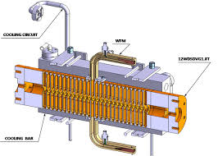
Latest developments at FREIA:
Approval in August 2017 by H2020 of two EU
INFRADEV-1 Design Studies, both of which have FREIA as partner:
Compact Light: developing an XFEL based on CLIC type compact normal-conducting linear collider – EUs contribution to FREIA is ca 1 Mkr
Molecular and material science
ESSnuSB: upgrading the ESS linac to 10 MW and using the extra 5 MW to generate a world-uniquely intense neutrino beam which will enable the study of leptonic CP violation as the origin of mater-antimatter asymmetry by measuring neutrino oscillations at the second oscillation maximum, where the signal is 3 times stronger that at the first maximum, where DUNE in the US and Hyper-K in Japan will measure – EU contributions to FREIA: last year 0.5 Mkr from the COST Association and now 5 Mkr from H2020/INFRADEV-1.
Particle physics

Slide 17
At end September 2017 FREIA is hosting at Uppsala University
the yearly International Workshop on Neutrinos from Accelerator
which attracts some 160 particle and accelerator physicists
from all the world.

Slide 18
FREIA Vision
Pursue physics research and development on the national and international level in collaboration with large research infrastructure and industry of accelerators and instrumentation for the development of new research instruments for Neutron Physics, Particle Physics, Synchrotron Radiation Physics, Medical Physics, Nuclear physics, Fusion Physics, Astronomy and Space Physics.

