Slide 1

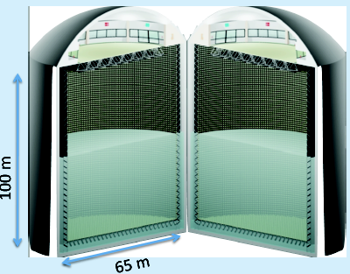
The physics case of the
proposed large Water
Cherenkov Detector
GRIPnu
SFS Particle Days Stockholm 6 November 2017
Tord Ekelöf
Uppsala University

Slide 2
The MEMPHYS WC Detector
(MEgaton Mass PHYSics)
Proton decay
SuperNova neutrinos
  Supernovae "relics"
Solar Neutrinos
Atmospheric Neutrinos
Neutrino Oscillations
500 kt fiducial volume (~20xSuperK)
Readout: ~240k 8” PMTs
30% optical coverage
(arXiv: hep-ex/0607026)

Slide 3
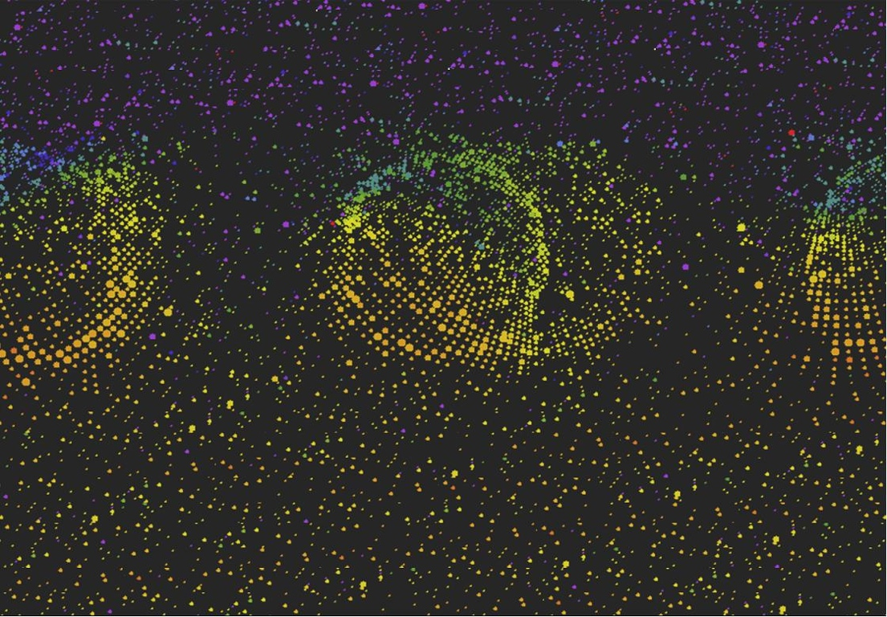
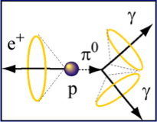
Proton Decay
3

Slide 4
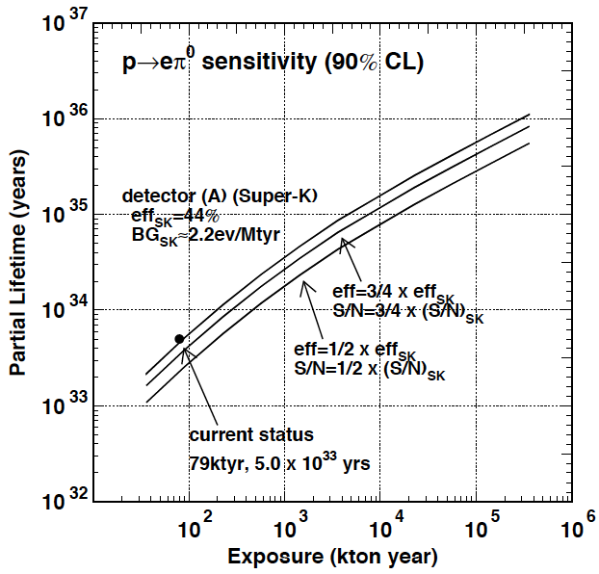
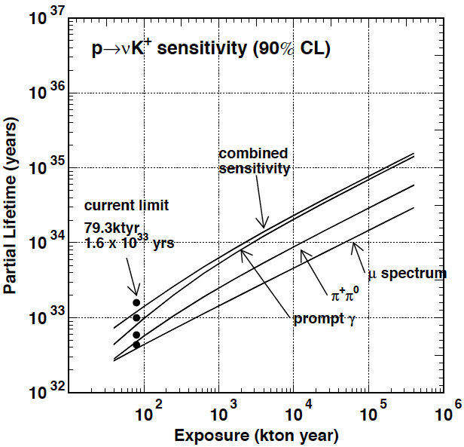
ESSnuSB-MEMPHYS sensitivities
proton decay
(arXiv: hep-ex/0607026)

Slide 5
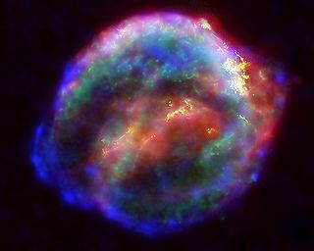
Supernova
5

Slide 6
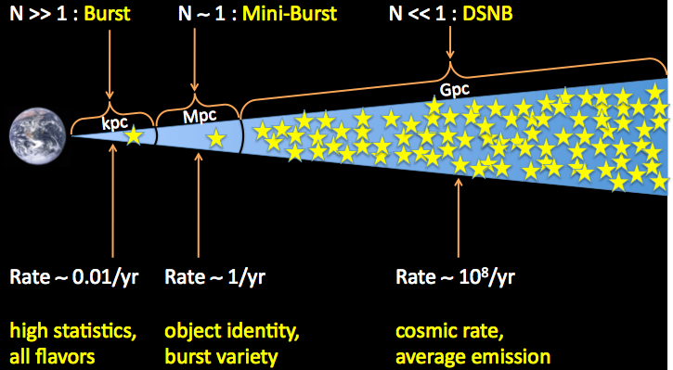
Distance scale and exp’d rate
Milky way
Nearby galaxies
Distant galaxies
6
Beacom@NU2012

Slide 7
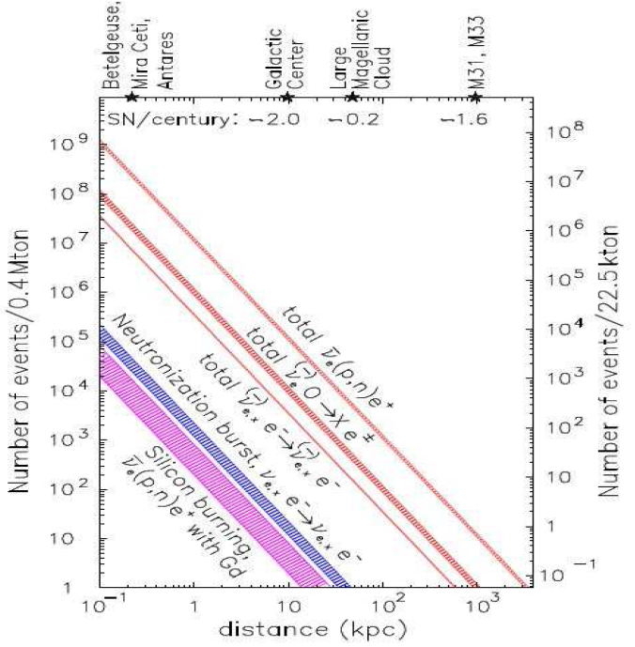
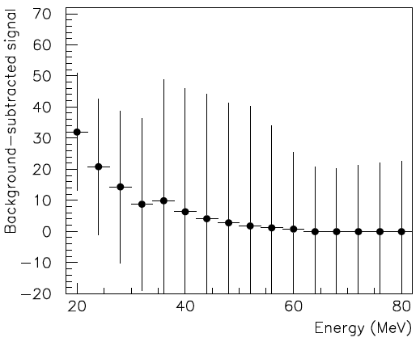
ESSnuSB-MEMPHYS sensitivities
Supernova explosion and relics
MEMPHYS
SUPERK
Diffuse Supernova Neutrinos
(10 years, 440 kt)
For 10 kpc: ~10⁵ events

Slide 8
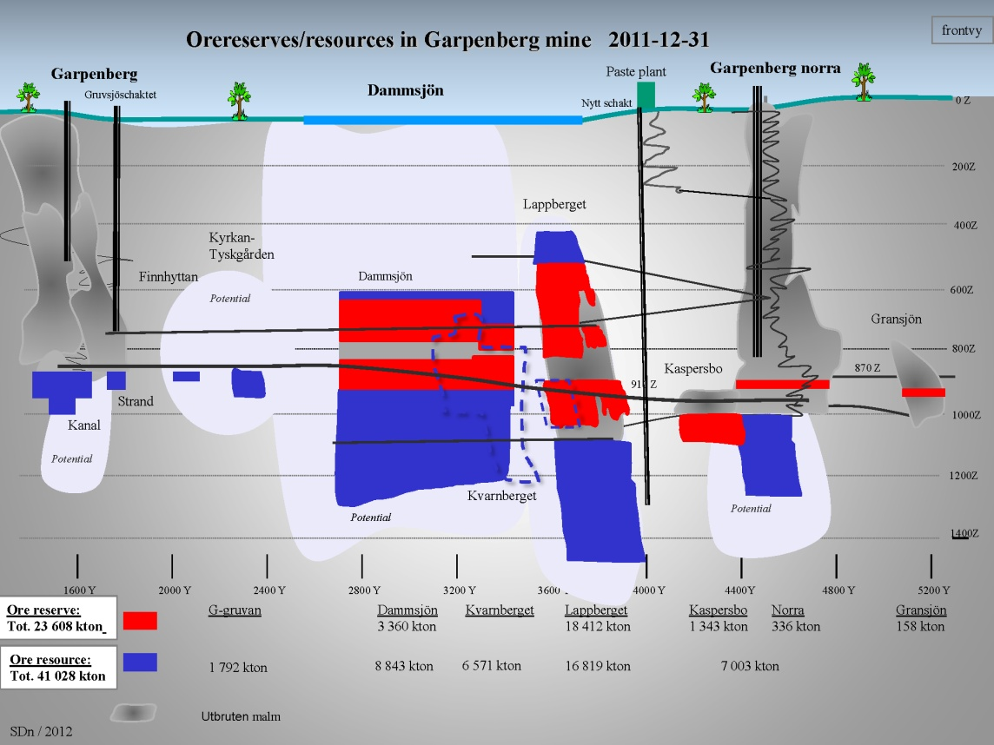
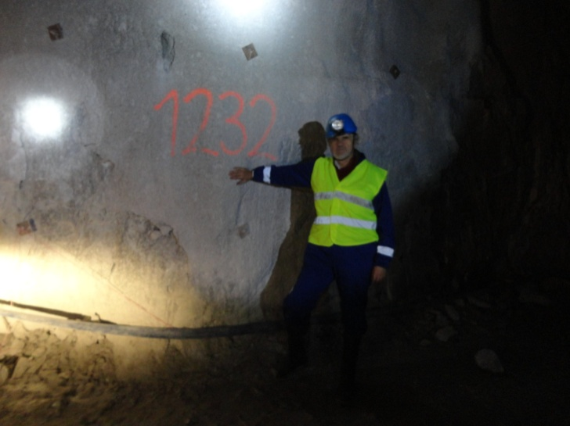
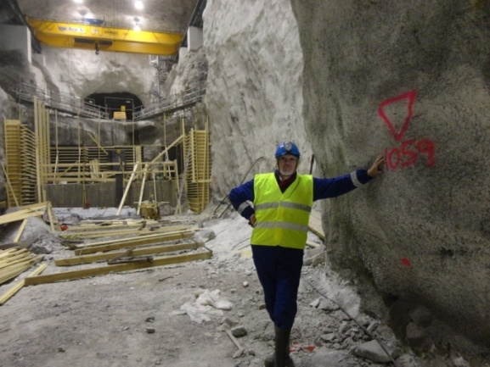
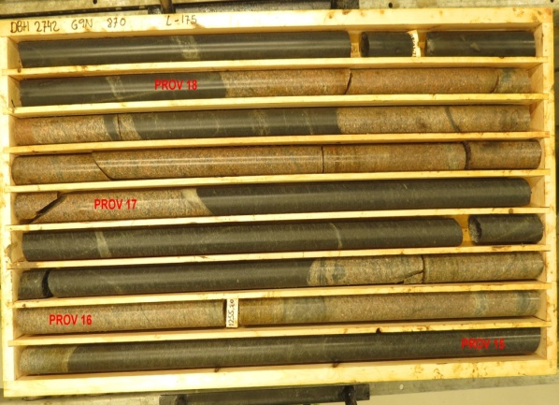
Gruvsjöschaktet
Nytt schakt
Garpenberg Mine
Distance from ESS Lund 540 km
Depth 1232 m
Truck access tunnels
Previously two ore-hoist shafts
SDn / 2012
Recently a new ore-hoist shaft
was taken into operation,
leaving the Garpenberg Norra
shaft free for other uses
Granite drill cores

Slide 9
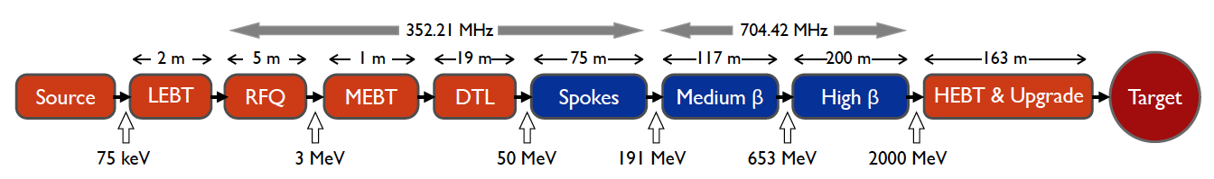
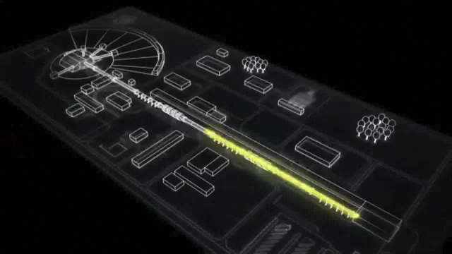
ESS proton linac is located 540 km from Garpenberg
With 5 MW average beam power and 2.7x10²³ protons on target per year the ESS linac will be the most powerful and intense proton accelerator in the world, ca 10 times more powerful than the current J-Park and FNAL proton accelerators
125 MW peak power.
14 pulses of 2.86 ms duration per second, each containig10¹⁵ protons.
Duty cycle 4%.
2.0 GeV protons, up to 3.5 GeV with linac upgrades
Linac ready by 2023 (full power)

Slide 10
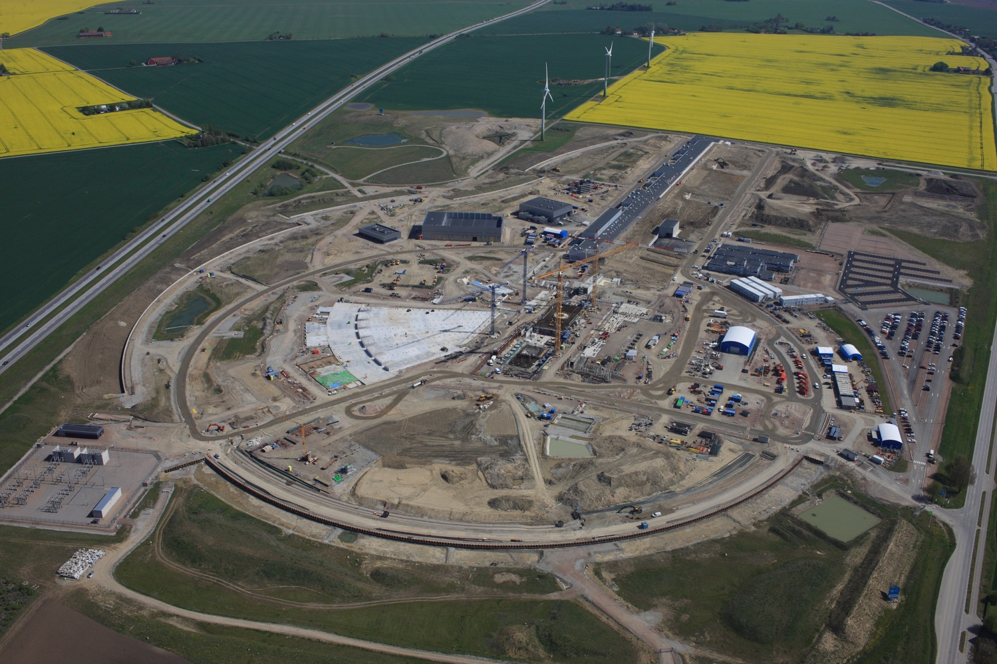
The neutron and neutrino beams
ν
p
n
H⁻
May 2017

Slide 11
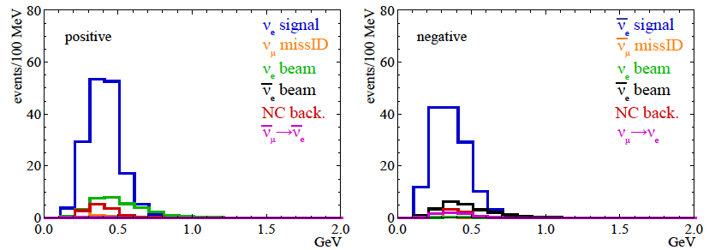
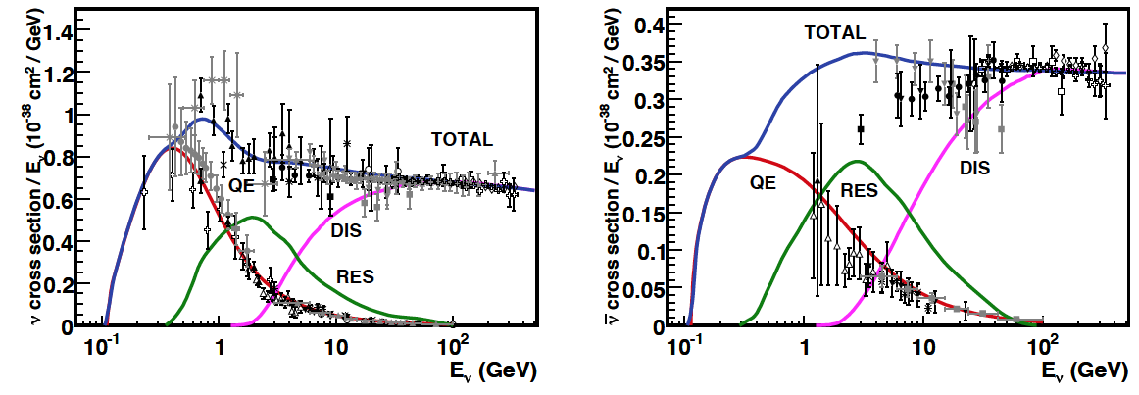
Neutrino spectra
540 km (2 GeV), 10 years
below ν_{τ} production, almost only QE events
neutrinos
anti-neutrinos
δ_{CP}=0
2 years
8 years

Slide 12
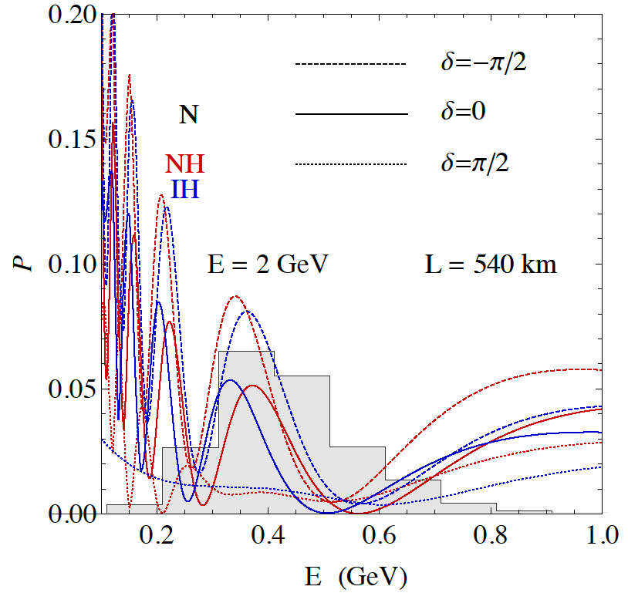
2nd Oscillation max. coverage
2nd oscillation max.
well covered by the ESS neutrino spectrum
2nd oscillation maximum
δ_{CP}=-90
δ_{CP}=0
δ_{CP}=+90
P(ν_{μ}→ν_{e})
θ₁₃=8.8º
("large" θ₁₃)
L/E
1st oscillation max.
L(2nd max) =1500 (km) x E (GeV) =1500x0.35 = 525 km
L(1st max) = 500 (km) x E(GeV) = 500x0.35 = 175 km

Slide 13
Physics Performance
little dependence on mass hierarchy (not so long baseline),
δ_{CP} coverage at 5 σ C.L. up to 60%,
δ_{CP} accuracy down to 6° at 0° and 180° (absence of CPV for these two values),
not yet optimized facility.

Slide 14

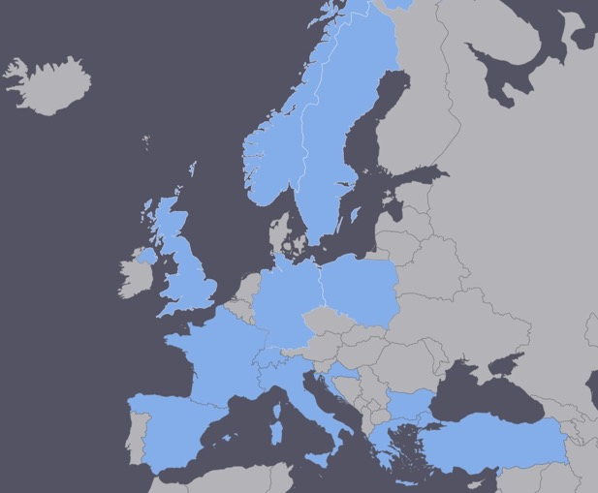
EU COST project for ESSνSB networking approved in 2016
  EuroNuNet : Combining forces for a novel European facility for neutrino-antineutrino symmetry violation discovery (http://www.cost.eu/COST_Actions/ca/CA15139
  Granted 0.5 MEUR)
Special session at the
NUFACT2017 worshop
  Major goals of EuroNuNet:
    to aggregate the community of neutrino physics in Europe to study the ESSνSB concept in a spirit of inclusiveness,
    to impact the priority list of High Energy Physics policy makers and of funding agencies to this new approach to the experimental discovery of leptonic CP violation.
  13 participating countries (network still growing).

Slide 15

A EU/H2020 project for a ESSνSB Design Study approved in August 2017
(Call INFRADEV-01-2017)
Title of Proposal: Discovery and using an intensive neutrino Super Beam generated with the exceptionally powerful ESS linear accelerator
Duration: 4 years
Total cost: 4.7 M€
EU grant: 3 M€
15 participating institutes from
11 European countries including CERN and ESS
6 Work Packages
ESSνSB
BENE (2004-2008)
ISS (2005-2007)
EUROν (2008-2012)
LAGUNA (2008-2010)
LAGUNA-LBNO (2010-2014)
COST Action CA15139 (2015-2019)

Slide 16
EU excellence criterion
4.5 of 5 poins
The proposal is addressing the use of ESS proton linac which would be tuned to provide up to an order of magnitude higher power proton
beams than the present linear accelerators. The upgrade of the linac to high intensity neutrino beam to address matter-antimatter asymmetry
in the lepton sector is very ambitious, is clearly innovative and beyond-the-state-of-the-art. It is a very well written proposal with clear
objectives and sound concept and scientific case. The proposed methodology is credible. The project has good interdisciplinary approach.
The proposal is timely and has advantages in costs and physics objectives over similar experiments.

Slide 17
Impact criterion
4.5 of 5 points
The project will have significant impact on enhancing attractiveness of Europe in future neutrino programs in the long baseline scheme. The
technical and scientific impacts due to the upgrade of ESS linac power, the construction of a high flux neutrino beam, implementation of the
near and far detectors and also the potential discovery of CP violation in the lepton sector are high. The project is strongly supported by the
main players in the field. CERN established a strong scientific case for long baseline neutrino program exploring CP violation. In addition, the
proposed design is recognized to address all critical issues by the scientific community. The project has a potential to increase and diversify the user community of ESS. Building an infrastructure in an currently unused mine will also have a local social impact.

Slide 18
Design Study ESSνSB
(2018-2021)
Very supportive letter from ESS director
The Grant Agreement has to be signed before the 23rd of November 2017 and the project will start 1 January 2018.
ESSνSB will start engaging postdocs soon.
partners: IHEP, BNL, SCK•CEN, SNS, PSI, RAL

Slide 20
Mats Lindroos’ summary of his talk on the ESS linac
ESS is well into construction and the accelerator project is progressing according to plan towards first beam for target in October 2020
The ESS facility is built by a collaboration of some 100 research institutes and universities
Installation has started of cryogenics and for the ion source
The Accelerator Division is recruiting according to plan and will be ready to take ownership of the accelerator, install it, commission it and enter it into operation
Most future large scale project are likely to be IK projects and this is a very powerful model. Together we are strongest!
(TE: “IK projects” assumes the full involvement of the AMICI-type EU Technological Infrastructures like STFC, DESY, PSI, INFN, CEA, IN2P3, CERN, IFJ-PAN, KIT & FREIA)
20

Slide 21
Mamad Eshrai’s conclusion of his talk on ESS linac upgrade
• The identified major modifications for the doubling of the beam power via a higher
repetition rate and higher beam energy are (in no particular order):
‣ Three new electrical substations along the RF gallery.
‣ A third main electrical station, alongside the 2 existing ones.
‣ HV cable trenches and pulling of additional HV cables from the main station towards the new substations. New HV cables between the substations and the modulators in the RF gallery.
‣ Installation of 8 new cryo modules and associated RF stations.
‣ Change of klystron collectors, so that 60% more average power can be produced. If klystrons are at the end of their lifetime, they could be exchanged against more powerful models.
‣ Installation of additional capacitor chargers to allow faster pulsing of the modulators. This is only possible if the modular design developed in-house is adopted.
‣ Installation of a H- source + RFQ + MEBT + beam funnel alongside the existing protons source.
‣ Exchange trim magnets and associated power supplies against pulsed versions
• The reviewers, Frank and Eric, did not find any show stoppers for the
addition of 5 MW H- acceleration capability in the current state of the ESS linac.
Ref.: Frank Gerigk and Eric Montesinos, CERN-ADD-NOTE-2016-0050

Slide 22
Onoing work on Memphys
The MEMPHYS code for simulation and reconstruction, written within the preceding EUROν project, has been revived and installed on the Iridium cluster at Lund University. A visualisation package, MEMPHYSvis, has been added. It could work on personal devices like mobile phones, tablets, etc. that makes it appealing for use outside of the experimental physics neutrino community.
A virtual machine has been set up and open for download and use by the members of the WG. It contains all the necessary libraries and specific to Detectors WG code so that a newcomer could download it and start working without the painful process of setting up the relevant software environment.
The MEMPHYS code has been tried by Peter Christiansen for setting up simulation of the water Cherenkov Near detector. Useful experience has been gained.

Slide 23
Garpenberg Research Infrastructure Project for Neutrinos (GRIPnu) http://www.physics.uu.se/digitalAssets/374/c_374310-l_1-k_gripnu-english-version.pdf

Slide 25
A slide from Mauro Mezzeto’s Future Outlook talk at NUFACT2017

Slide 26
Where do we go from here?
The ESSnuSB technically limited time schedule:
2018-2021 Design Study -> Conceptual Design Report
2021-2023 Preparatory Phase -> Technical Design Report
2024-2030 Build-up of ESSnuSB
2031-2040 Data taking -> CP angle and other measurement
To this must be added the extra time, less straightforward to estimate, of political negotiations which will in any case imply the need for a least a few more years
In order to get EU financing 2021 for the Preparatory Phase we need to deliver convincing Design Study results by latest autumn 2019 as input to the CERN Strategy Council preparation of its input to the ESFRI update in 2020
This leaves us only from autumn 2027 to autumn 2019, 2 years, to achieve sufficient progress to convince the CERN Strategy Council to recommend us for being included on the ESFRI list.

Slide 27
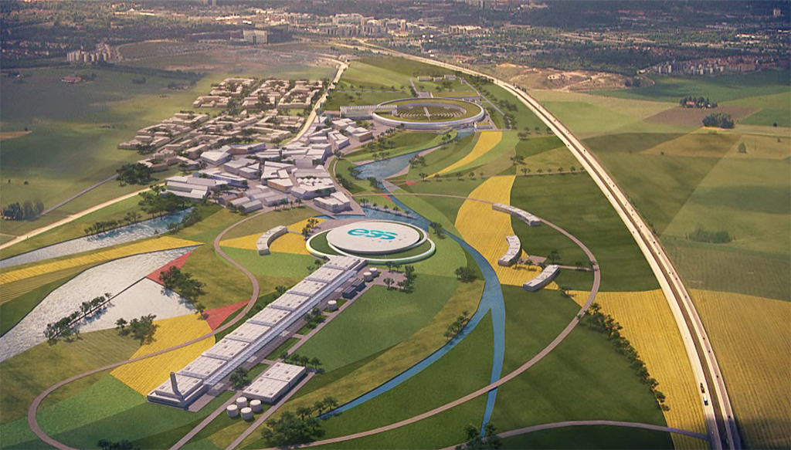
Conclusions
The large ν detector has a rich astroparticle and p lifetime program.
Significantly better CPV sensitivity at the 2nd oscillation maximum.
The European Spallation Source Linac will be ready in less than 8 years (5 MW, 2 GeV proton beam by 2023).
ESS will have enough protons to go to the 2nd oscillation maximum and increase its CPV sensitivity.
CPV: 5 σ could be reached over 60% of δ_{CP} range (ESSνSB) with large potentiality.
EU COST network project supports ESSνSB
EU/H2020 has decided to finance an ESSνSB Design Study project which will start 1 January 2018.

Slide 28
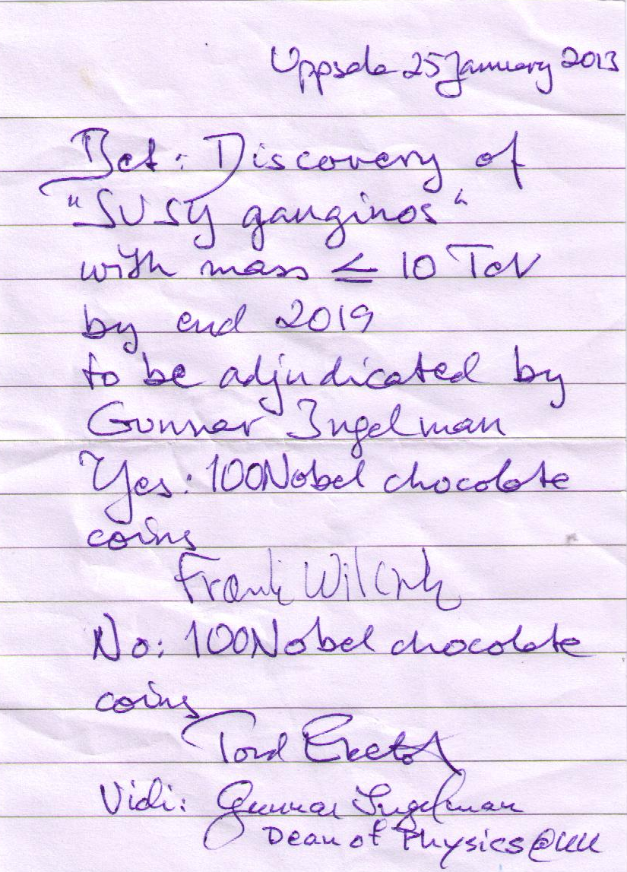
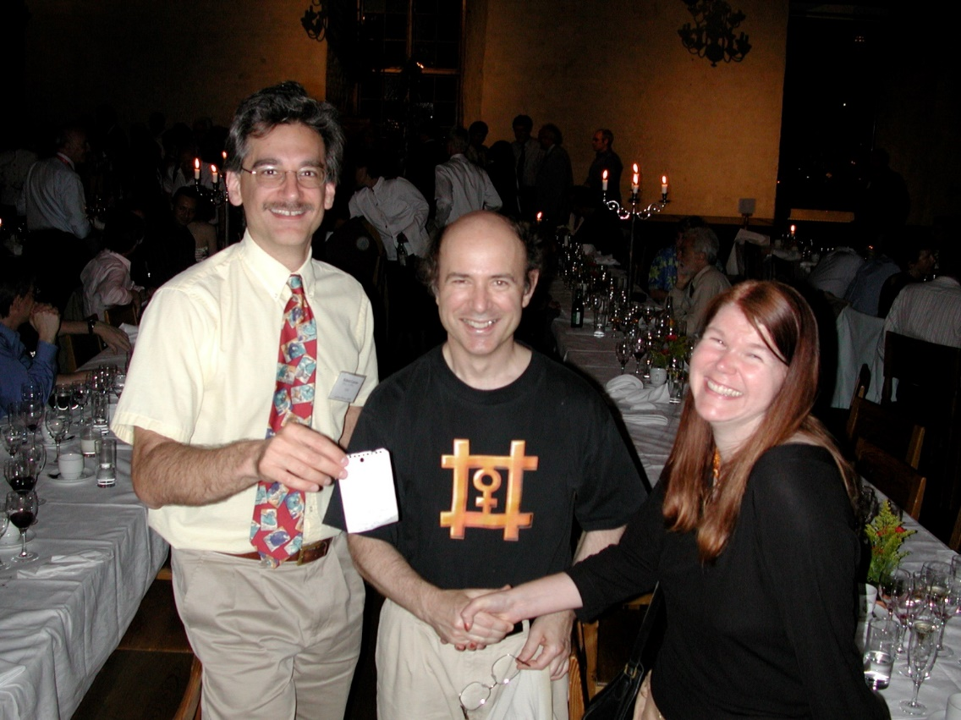
In view of the next talk on the program:
Betting on the Higgs bosonen and
on Supersymmetri
Wilczek - Conrad bet
2012 on the Higgs boson
Wilczek – Ekelöf bet
2019 on SUSY gauginos

