Slide 1
Interface, exformation and Hermes' dilemma:
Ethnological perspectives on tour guides
Owe Ronström
Professor in Ethnology
Department for cultural anthropology and ethnology
Uppsala University
Sustainable visits workshop, 7-8 dec 2017
Campus Gotland

Slide 2
Three parts:
Interface
Exformation
Hermes’ dilemma

Slide 3




Slide 4
Interface:
“a zone of affordances organized to support and provoke activities and behaviours probabilistically, rather than mechanically” (Drucker 2011:3, 7-8).
“a critical point of intersection between different life worlds” (Long 2001)
“a surface where the necessary contact between interactors and tasks allow functions to be performed” (Laurel 1990)

Slide 5
Interface:
“a mediating environment and a critical zone that constitutes a user experience.”
not passive or neutral
an active producer both of what is transmitted and of the recipients

Slide 6

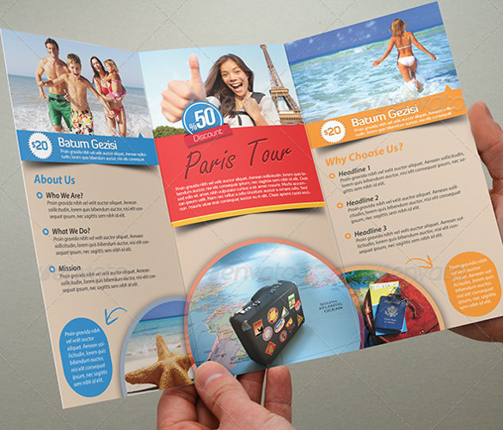
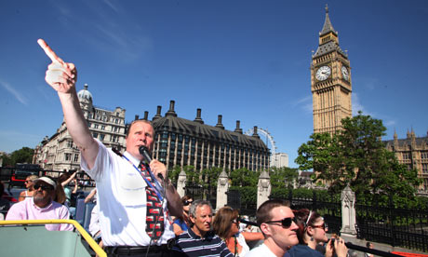


Slide 7
Exformation:
?
!

Slide 8
? !
Information
Exformation

Slide 9
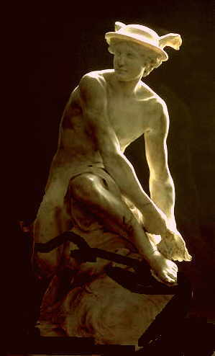
Hermes’ dilemma

Slide 10
Three aspects on tour guides and guiding:
Interface
Exformation
Hermes’ dilemma
Conclusive remarks

